Slide 1
Data FAIRification using RStudio workflows
Notes:
Start the talk with the usual spiel about how we collaborate with researchers and the we need processed to ensure things run smoothly

Slide 2
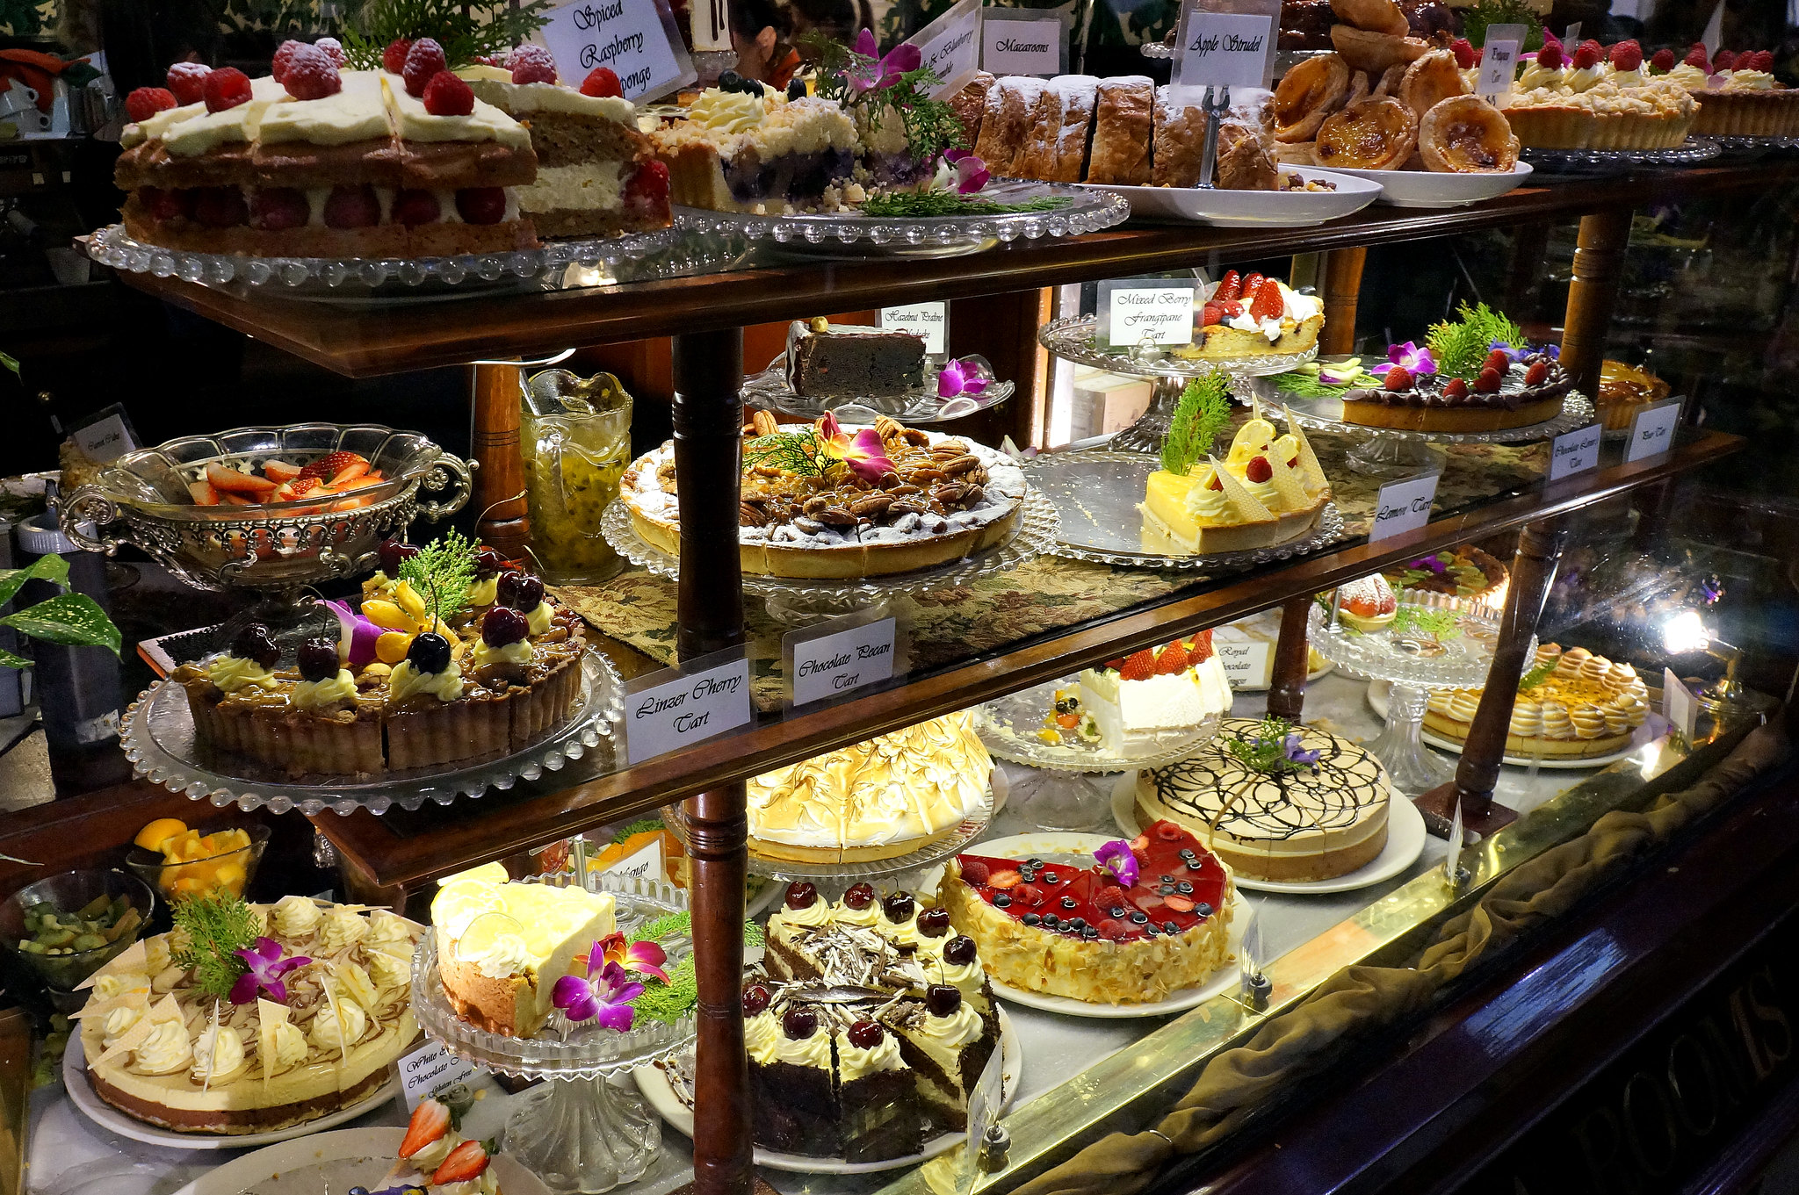
Where to begin…
Notes:
There are so many solutions out there.
Don’t try and stuff yourself with everything!

Slide 3
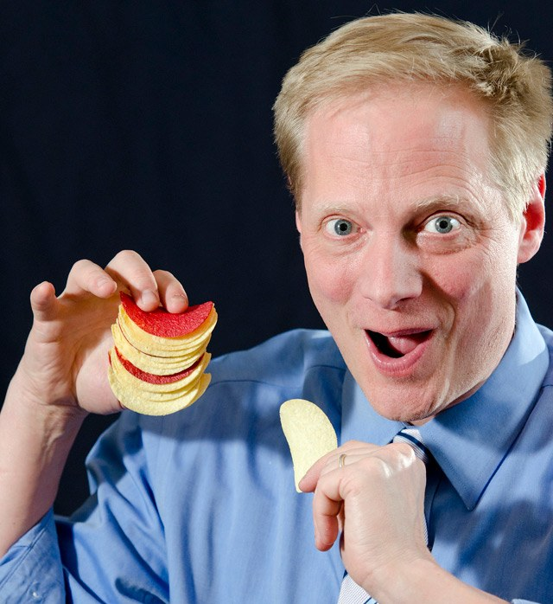
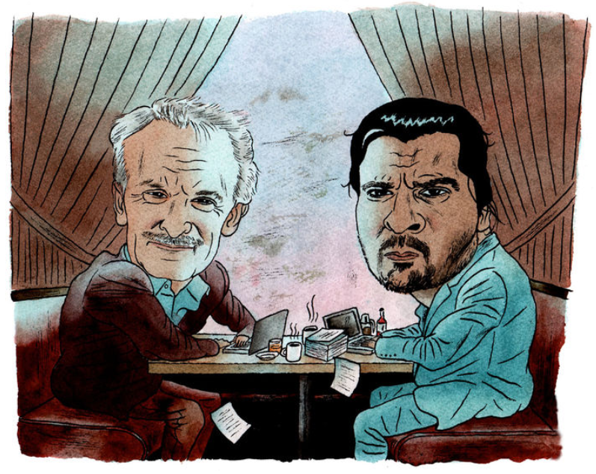
Don’t do what Donny Dont does!
“In short, peer review misses all the hard stuff, and a worrying amount of the easy stuff”
James Heathers,
Northwestern University
#datathugs
Brian Wansink: The grad student who never said no
“Every day we would scratch our heads, ask "Why," and come up with another way to reanalyze the data with yet another set of plausible hypotheses. Eventually we started discovering solutions”
Notes:
Wansink was a marketing professor at Cornell’s business college who was the director of the university’s Food and Brand Lab
Appointed as the executive director of the USDA's Center for Nutrition Policy and Promotion from November 2007 through January 2009. He was responsible for oversight of the 2010 Dietary Guidelines
- Had hypothesis, collected data, analysis not significant, p-hacked his way towards 5 papers from the original data
Six months after arriving, the Turkish woman had one paper accepted, two papers with revision requests, and two others that were submitted (and were eventually accepted -- see below). In comparison, the post-doc left after a year (and also left academia) with 1/4 as much published (per month) as the Turkish woman. I think the person was also resentful of the Turkish woman.

Slide 4
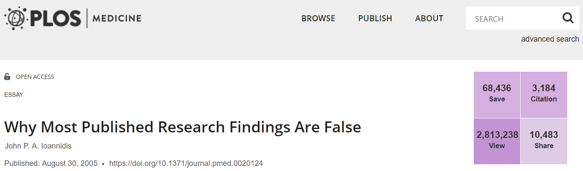

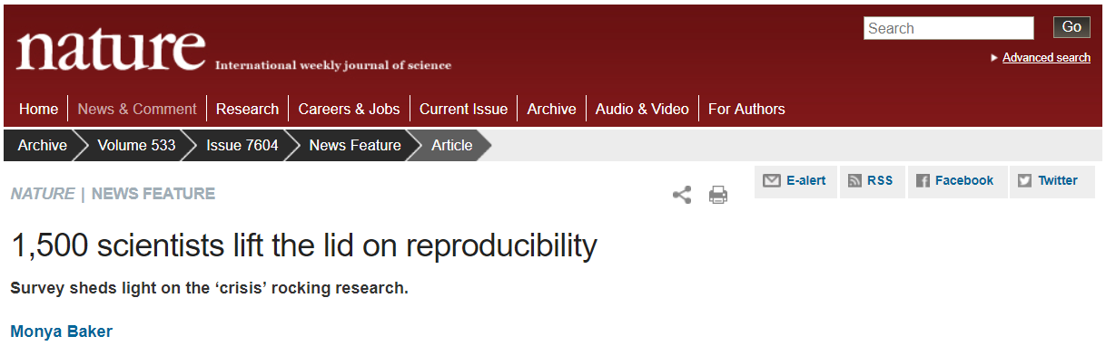
Credibility crisis
2005
2018
2016

Slide 5
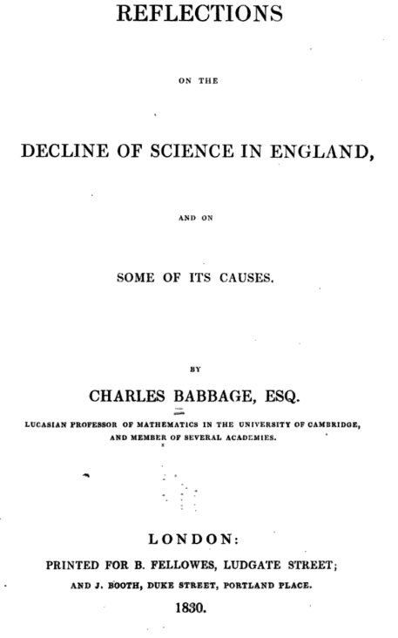
1830

Slide 6
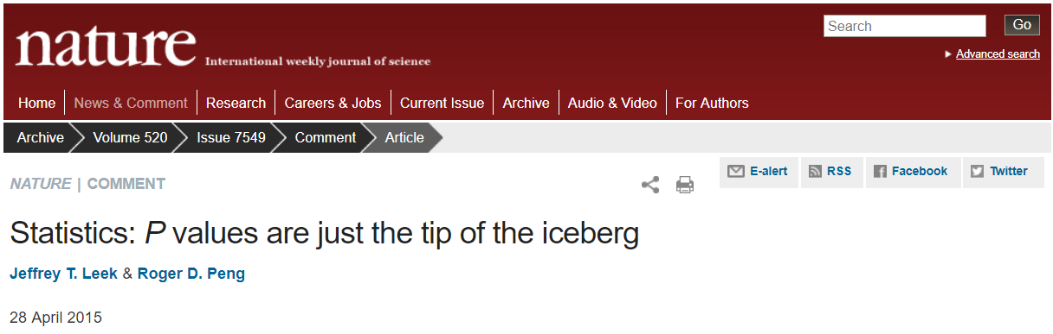
p-values should not define a study
Experimental design
Clean data
Modelling / Analysis
Raw data
Summary statistics
Findings
Notes:
Data collection
Data cleaning
Exploratory data analysis
Statistical modelling
Inference

Slide 7
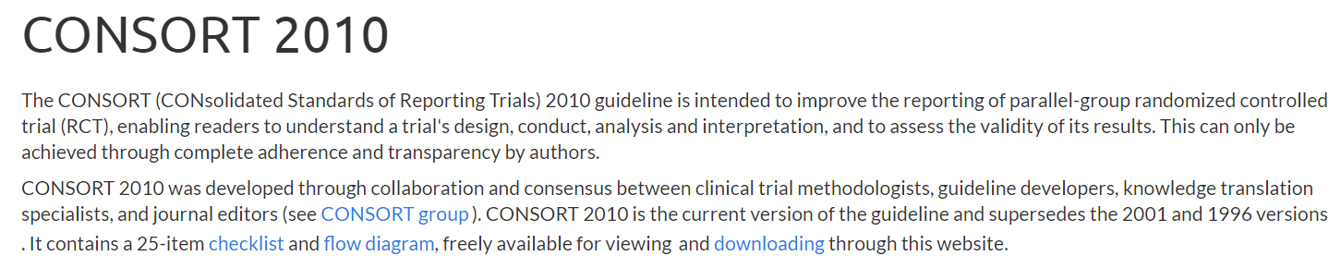
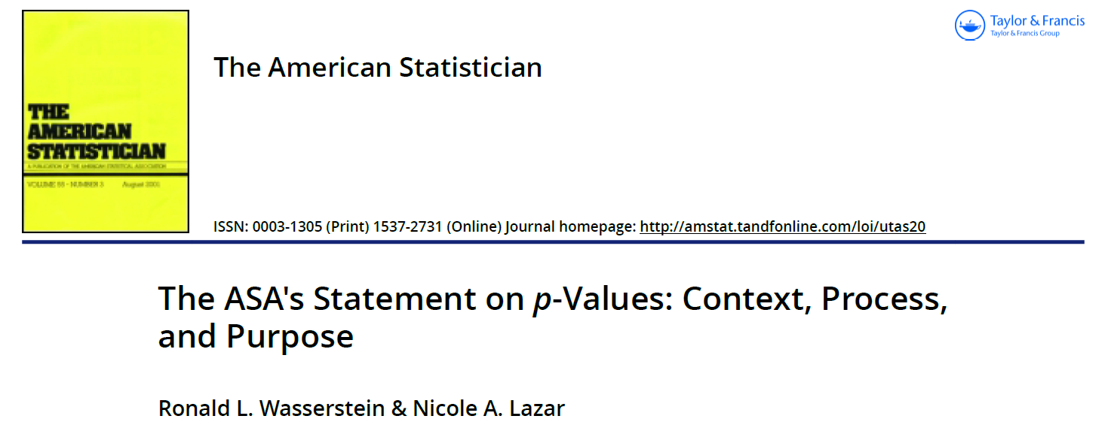
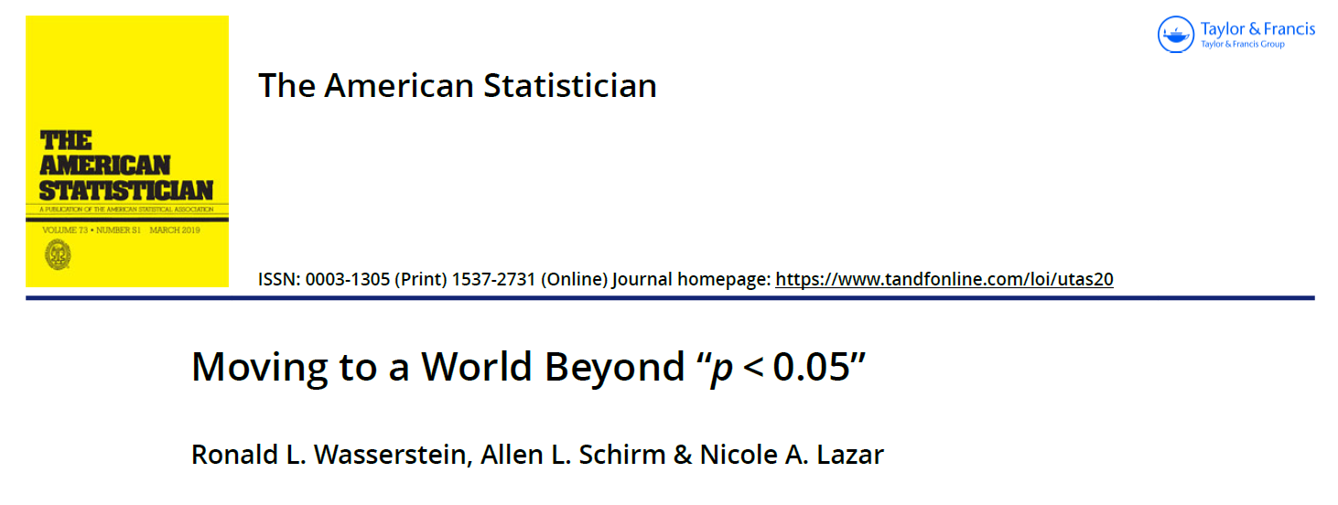
The winds of change

Slide 8
Today
Number of studies
Quality
Notes:
We could think of research quality existing on a spectrum with a distribution
Some researchers are awful and make stuff up (you might have seen some examples of this earlier in the day)
Some researchers ae frankly brilliant at doing high quality reproducible research and most of us are somewhere in the middle

Slide 9
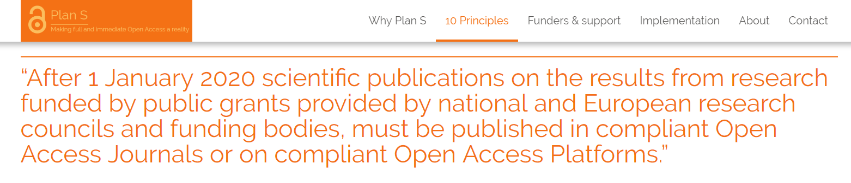
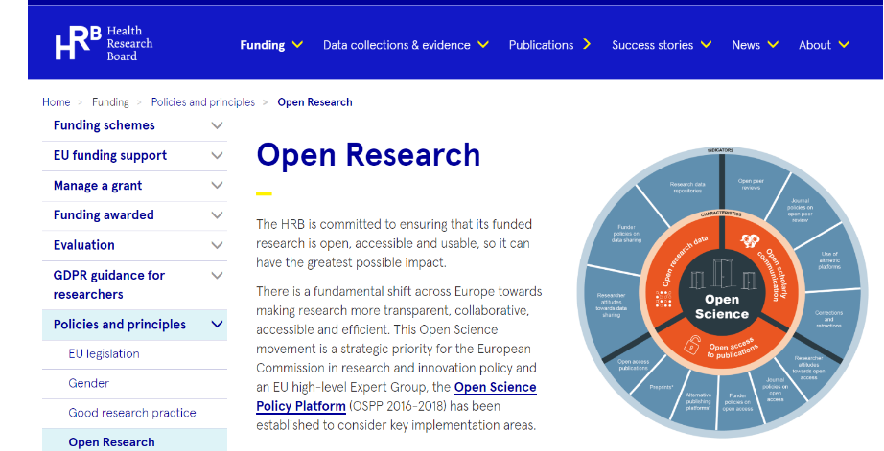


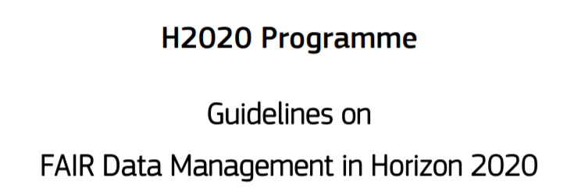
The butterfly has started flapping its wings
Notes:
Funders are looking for more than publications. Credit is there for other research derived objects
General Recommendation
Do not use journal-based metrics, such as Journal Impact Factors, as a surrogate measure of the quality of individual research articles, to assess an individual scientist’s contributions, or in hiring, promotion, or funding decisions.
For funding agencies
2. Be explicit about the criteria used in evaluating the scientific productivity of grant applicants and clearly highlight, especially for early-stage investigators, that the scientific content of a paper is much more important than publication metrics or the identity of the journal in which it was published.
3. For the purposes of research assessment, consider the value and impact of all research outputs (including datasets and software) in addition to research publications, and consider a broad range of impact measures including qualitative indicators of research impact, such as influence on policy and practice.

Slide 10
Tomorrow
Number of studies
Quality
Notes:
If we can shift the distribution just a little bit, it can make a big difference

Slide 11


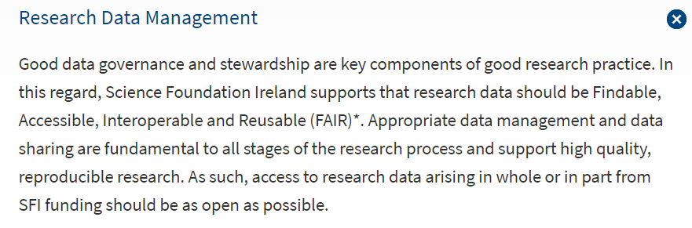
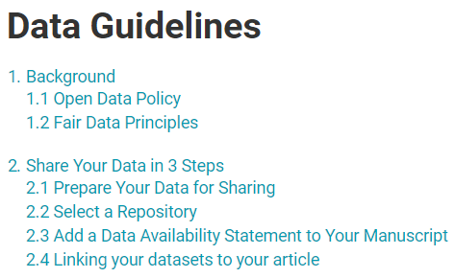
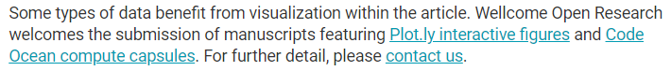

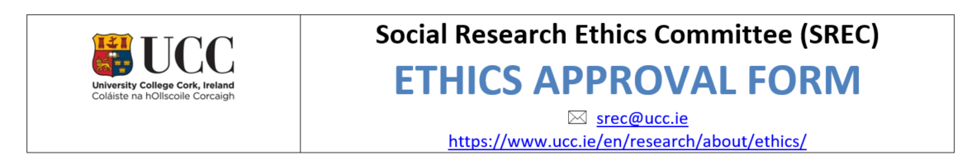

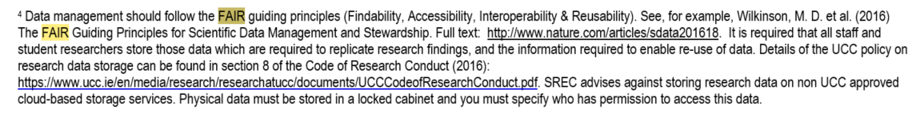
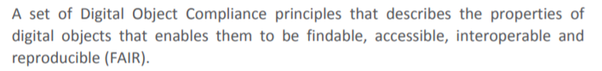
FAIR is a part of your life now!

Slide 12
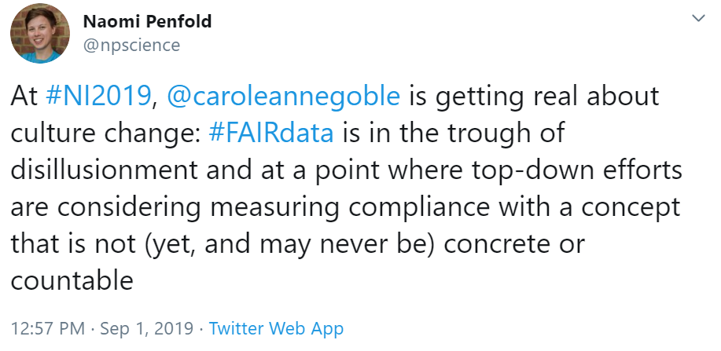
But what does that mean?
Notes:
NI2019 – Neuroinformatics 2019

Slide 13
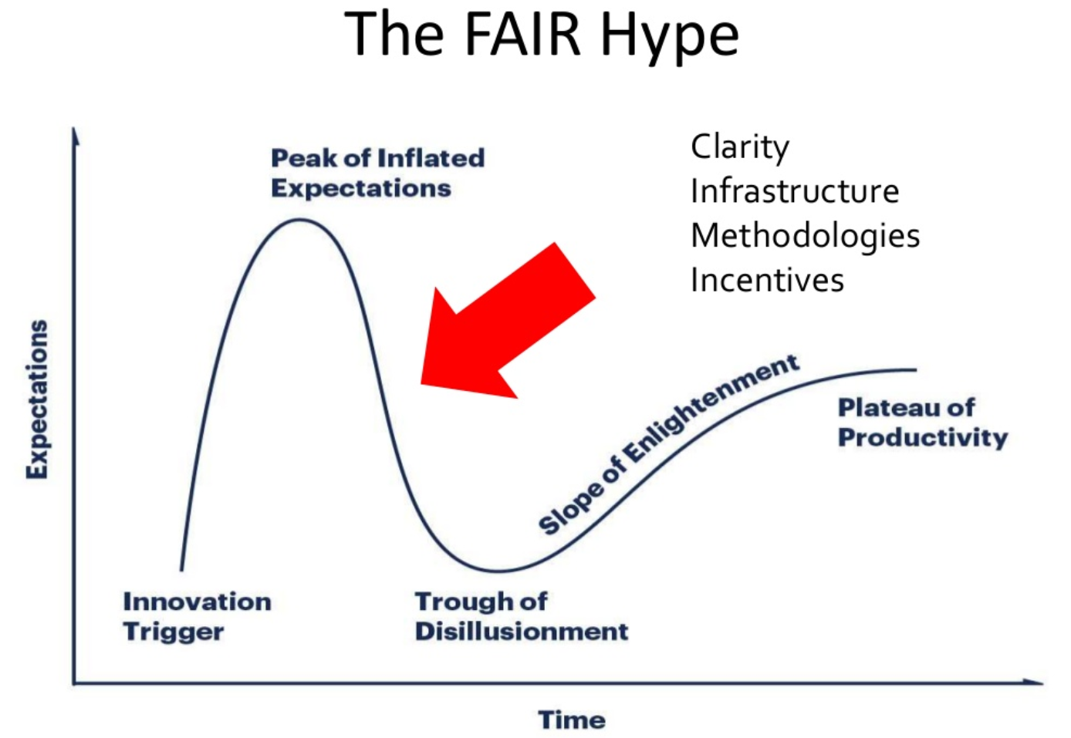
FAIR Safari – Prof Carole Goble
13

Slide 14
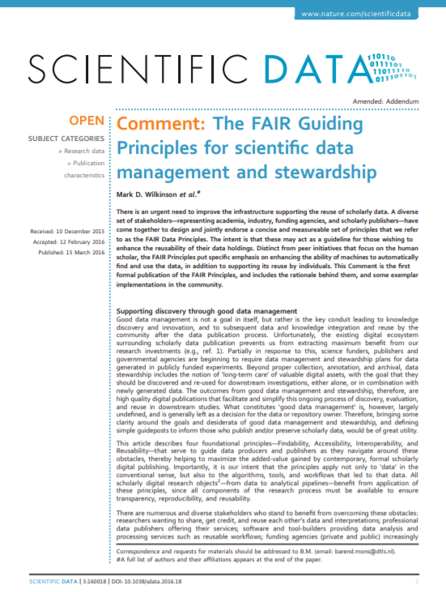
What are the FAIR data principles
A minimal set of community agreed guiding principles and practices to ensure that research data is:
- Findable
- Accessible
- Interoperable
- Reusable
Initially developed by Dutch Tech Centre for the Life Sciences
Reviewed and refined through multi-stakeholder practitioner groups, including Force11 and the Research Data Alliance

Slide 15
What are the FAIR data principles
Findable - Assign persistent IDs
- Machine readable descriptions to support structured searches
Accessible - Retrievable using a standard protocol
- Metadata available, even if data aren’t
- Authentication and authorization procedure
Interoperable - Uses standard (FAIR) vocabularies
- Linked to other resources
Reusable - Clear licenses
- Provenance
- Meets domain-relevant community standards

Slide 16
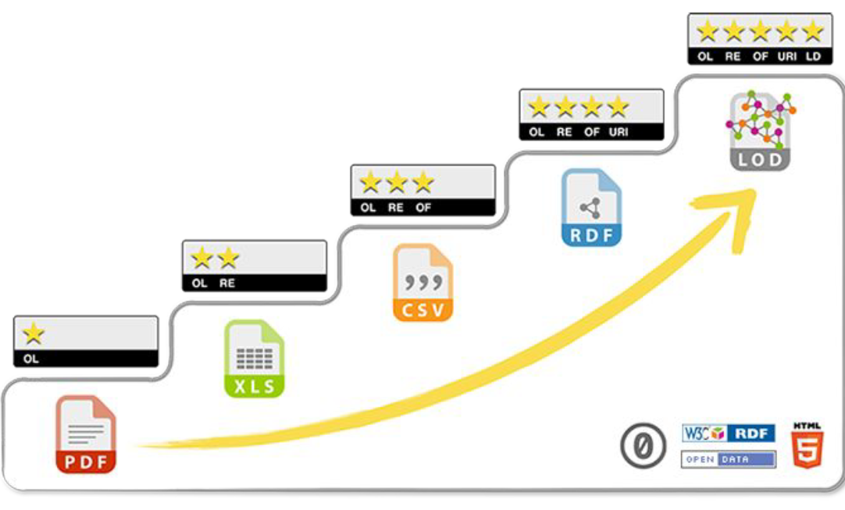
A path towards FAIR
Interlink your data to other information
Use Uniform Resource Identifiers (URI) that will point at to your work
Make it available in a non-proprietary open format (e.g., CSV instead of Excel)
Make it available in a structured format
Make it available in any format
Image: 5 ★ OPEN DATA
Notes:
Open the 5 star data link?
For three star you remove potential proprietary software to access the data
The Resource Description Framework (RDF) is a family of World Wide Web Consortium (W3C) specifications originally designed as a metadata data model.
The linked open vocabularies can themselves be expressed as Web data

Slide 17
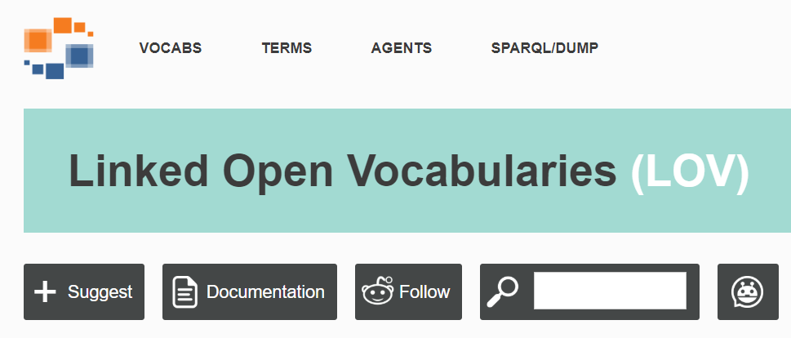
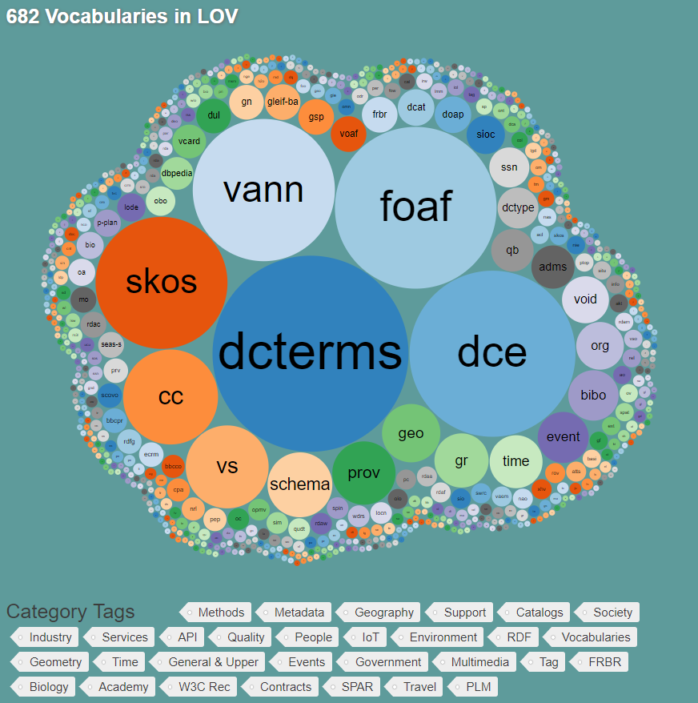
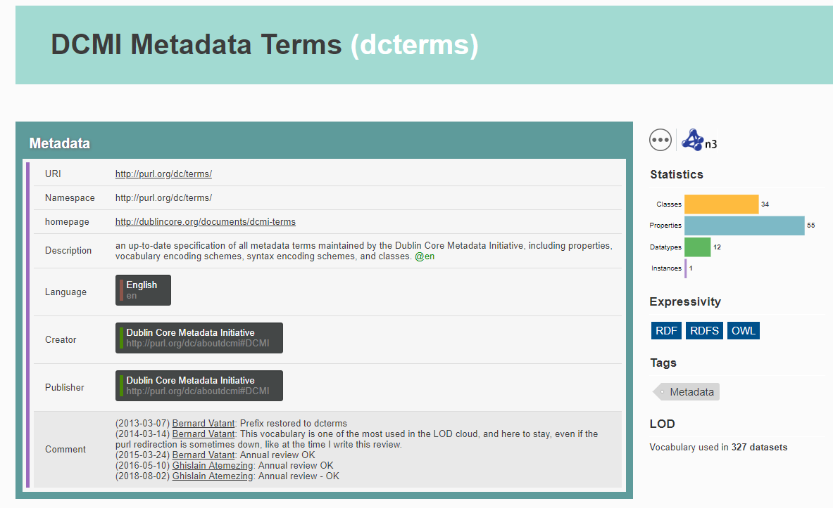
Advanced FAIRification – linked vocabularies
Notes:
dcterms – Dublin Core Metatdata intiative Metadata Terms
foaf – friend of a friend vocabulary
skos - Simple Knowledge Organization System
Data on the Web use properties (aka predicates) and classes (aka types) to describe people, places, products, events, and any kind of things whatsoever. In the data "Mary is a person, her family name is Watson, she lives is the city of San Francisco", "Person" is the class of Mary, "City" is the class of San Francisco, "family name" and "lives is" are properties used to describe a person, the latter acting also as a link between a person and a place
Downstream from where we are now. Requires resourcing and dedicated personnel
i.e. Not down to the individual researcher

Slide 18
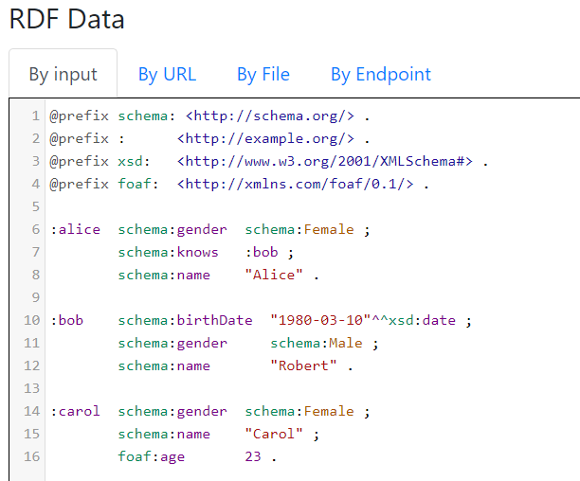

Slide 19
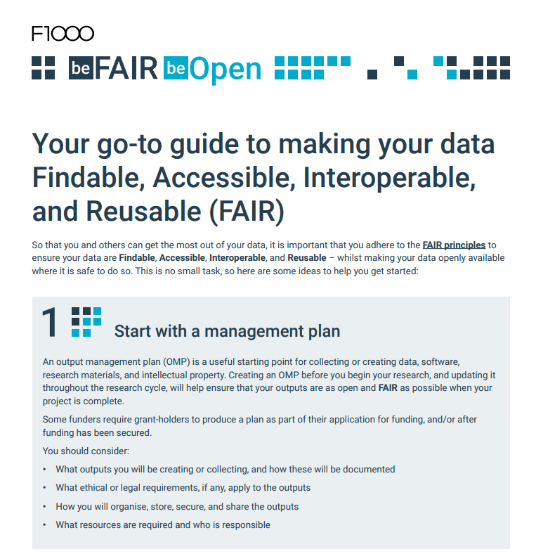
Incorporating FAIR into your routine workflow

Slide 20
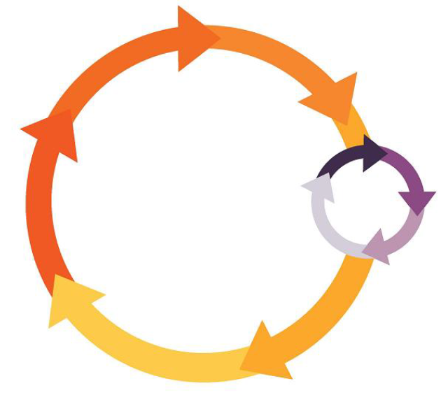
Incorporating FAIR into your routine workflow
Data Management Plan
Discover/Re-use data
Pre-award
Collect, Process, Analyse, Organise, Select, Clean, Describe, Document
Project close
Publish/Archive datasets
Notes:
NOTE: What formats, data organisation, documentation would YOU want/need to understand & re use YOUR data/code/protocol?

Slide 21
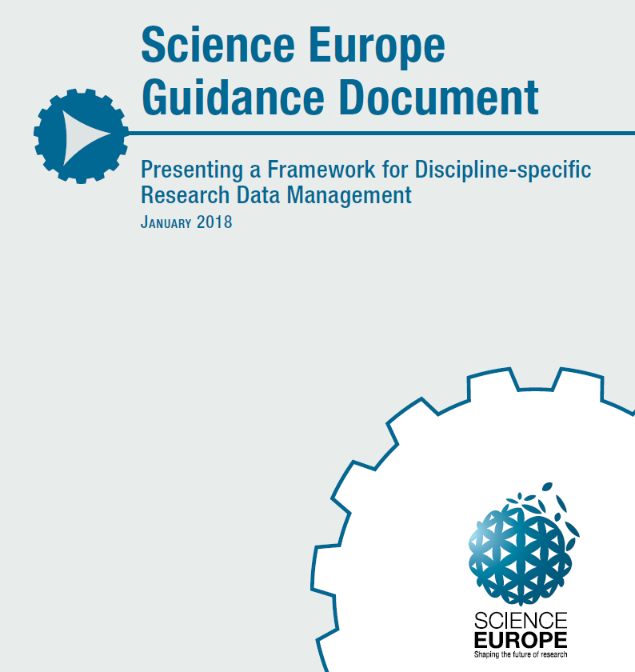
It all starts with a Data Management Plan
Seven main headings:
Data collection
Documentation and Meta-data
Ethics and Legal Compliance
Storage and Backup
Selection and Preservation
Data Sharing
Responsibilities and Resources

Slide 22
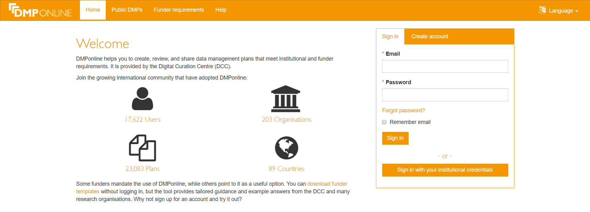
Taking those first steps
Notes:
This plan is based on the "Wellcome Trust Template"

Slide 23
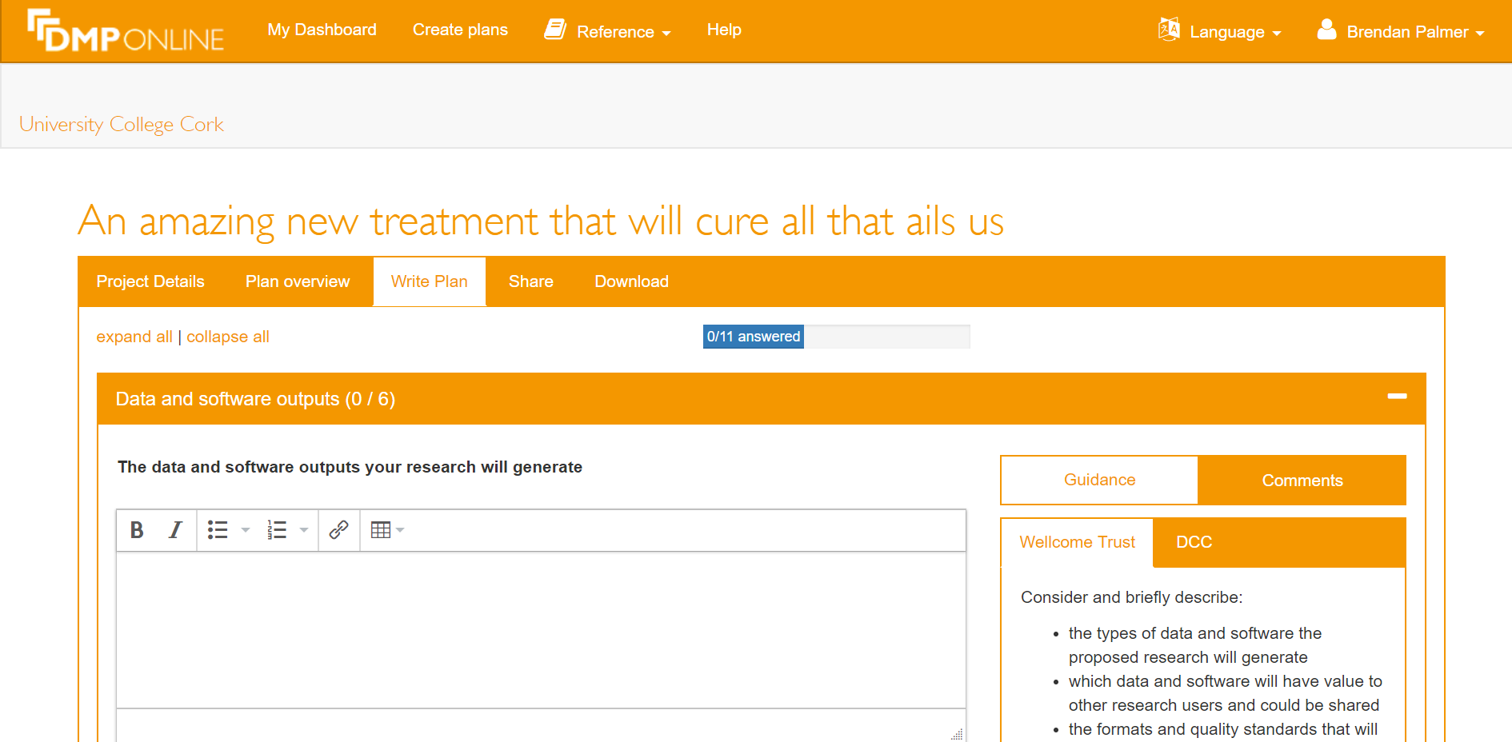
Notes:
- This plan is based on the "Wellcome Trust Template which was set ass the funder when the document began
- The guidance for a number of funding agencies is available/linked
Alternatively you can follow the DCC guidance

Slide 24
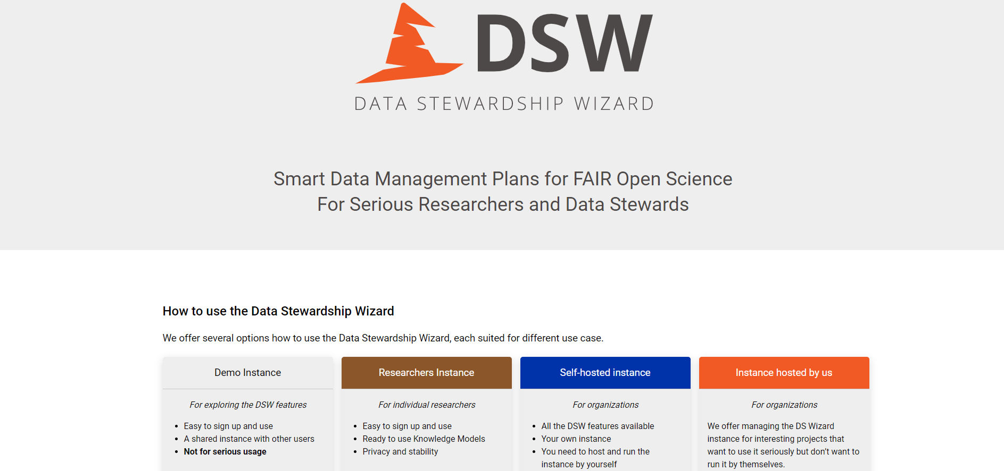
Taking those first steps

Slide 25
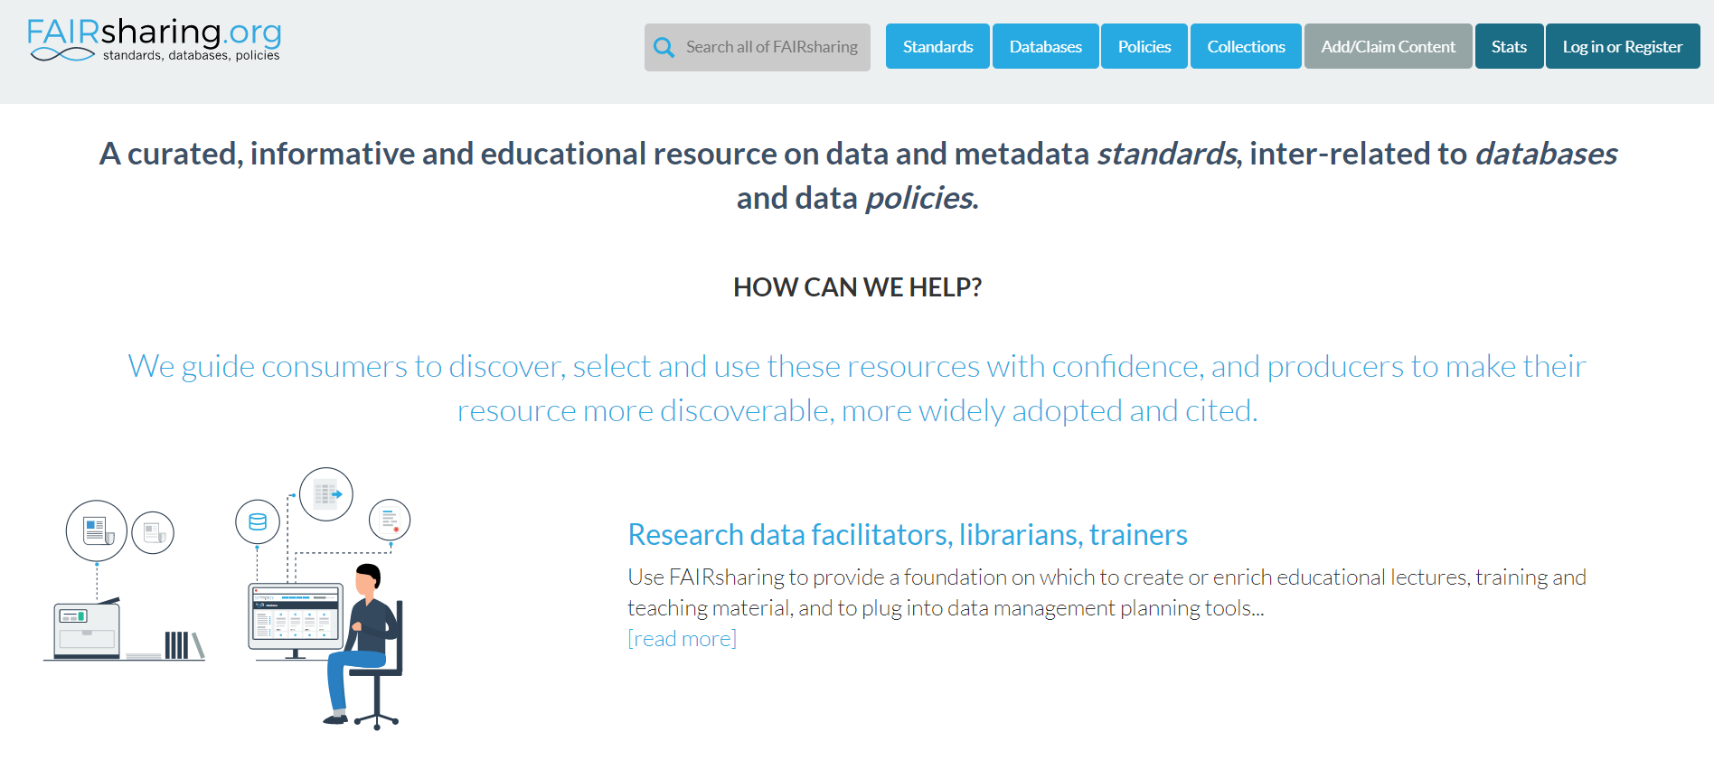
Exploring standards in your field
Notes:
Prepare Your Data for Sharing
- Before you begin, we strongly suggest that you consult FAIRSharing.org for details of data standards specific to the topic of your research. Depending on your field of study, there may already be standards in place that will help guide how your data should be structured, formatted, and annotated.
When depositing data involving human participants, authors must ensure that all datasets have been de-identified in accordance with the Safe Harbor method before submission.

Slide 26
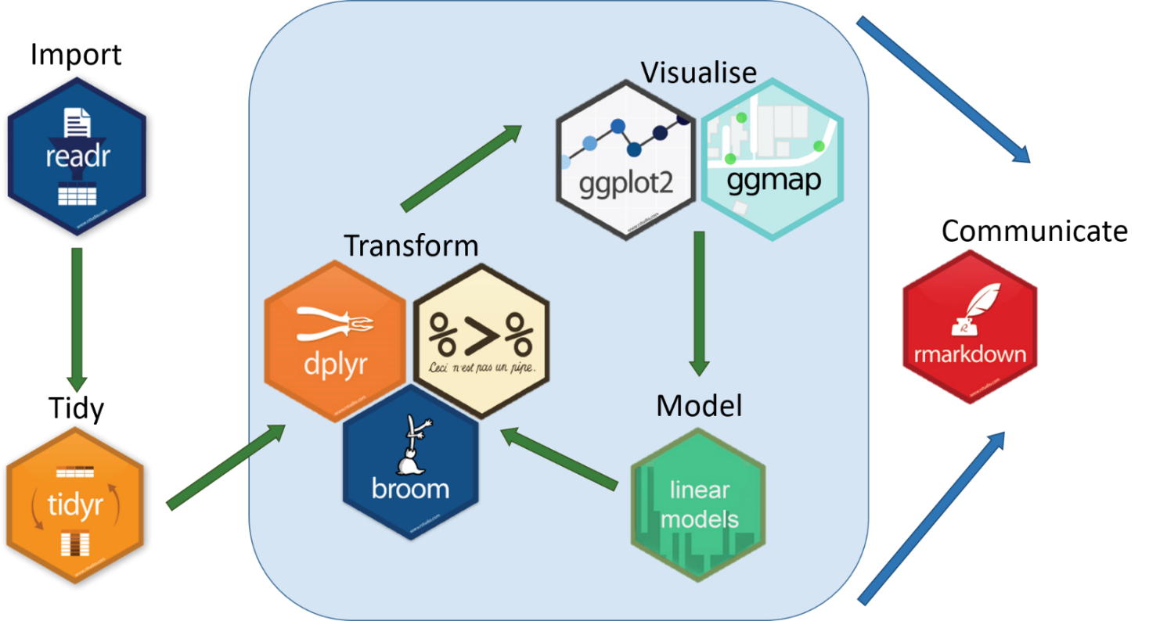
Putting the pieces together using R

Slide 27

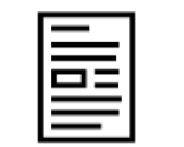

The bigger picture
Publications
Data Package
Version control
Collaborators

Slide 28
The ‘Open Science’ picture
Open Access
Open Source
Open Data

Slide 29
The ‘Open Science’ picture
Open Materials

Slide 30





What does this allow us to do?
analysis
data
raw_data
README.txt
codebook
project.Rproj
scripts
project.Rmd
plots
README.md
tables
A.N. Other
OSF / DOI
Repository / DOI
data
project.Rproj
raw_data
project.Rmd
README.txt
README.md
codebook
LICENCE
scripts

Slide 31
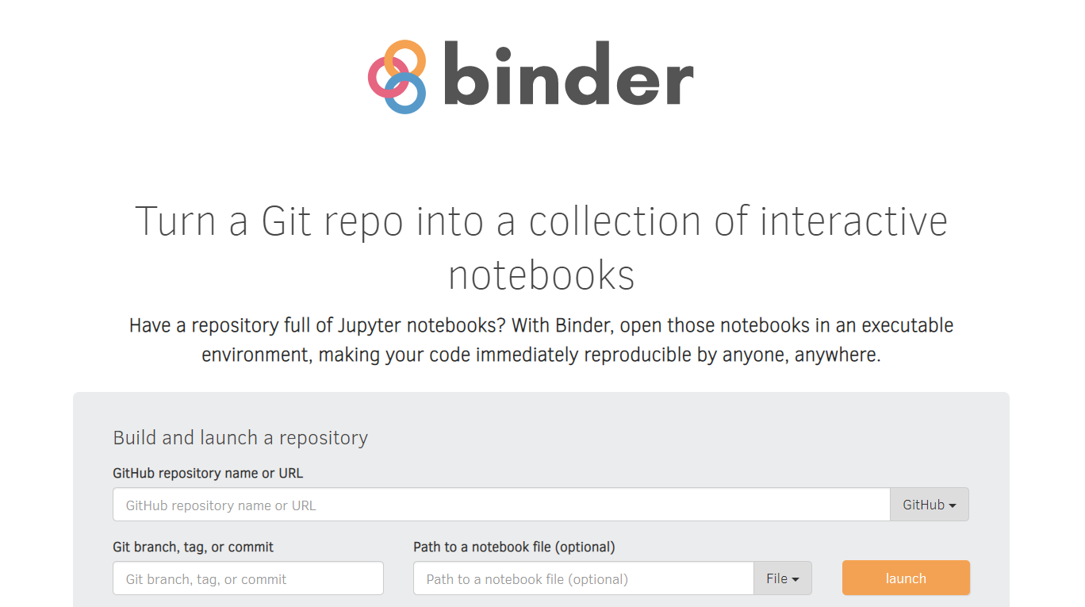
Project Packaging
Notes:
Open source that encompasses python and R oriented work

Slide 32
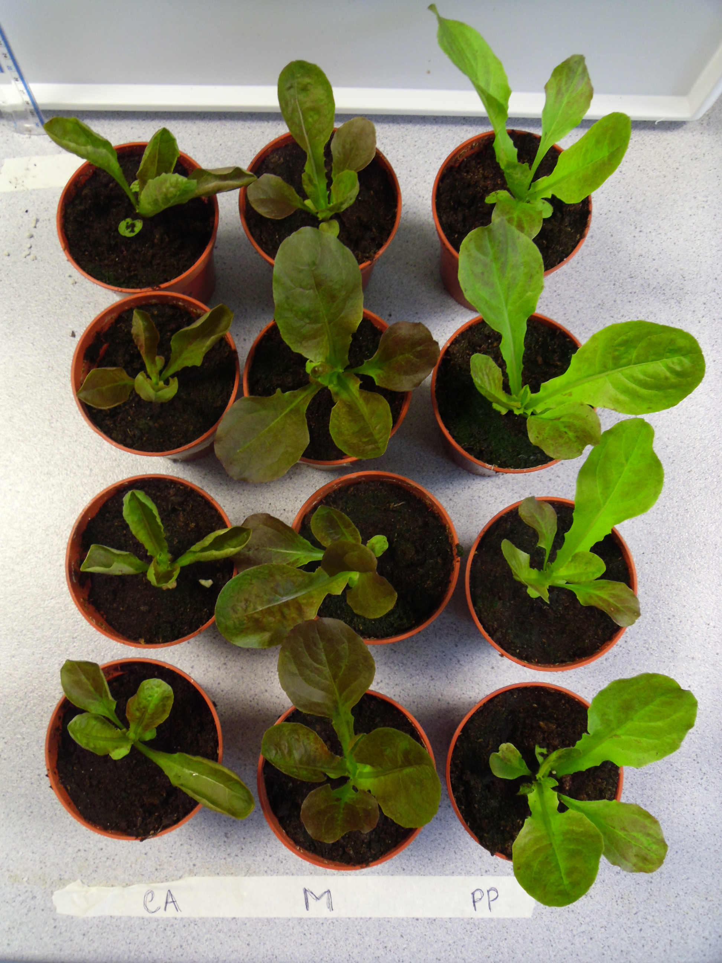
Our real life experiment
UV light has potential to change the secondary metabolite composition (colour) of bronze/red lettuce
Experimental setup:
3 lettuce varieties
3 UV filter conditions
3 weeks duration
Full Light Spectrum
Just UVA
No UV

Slide 33
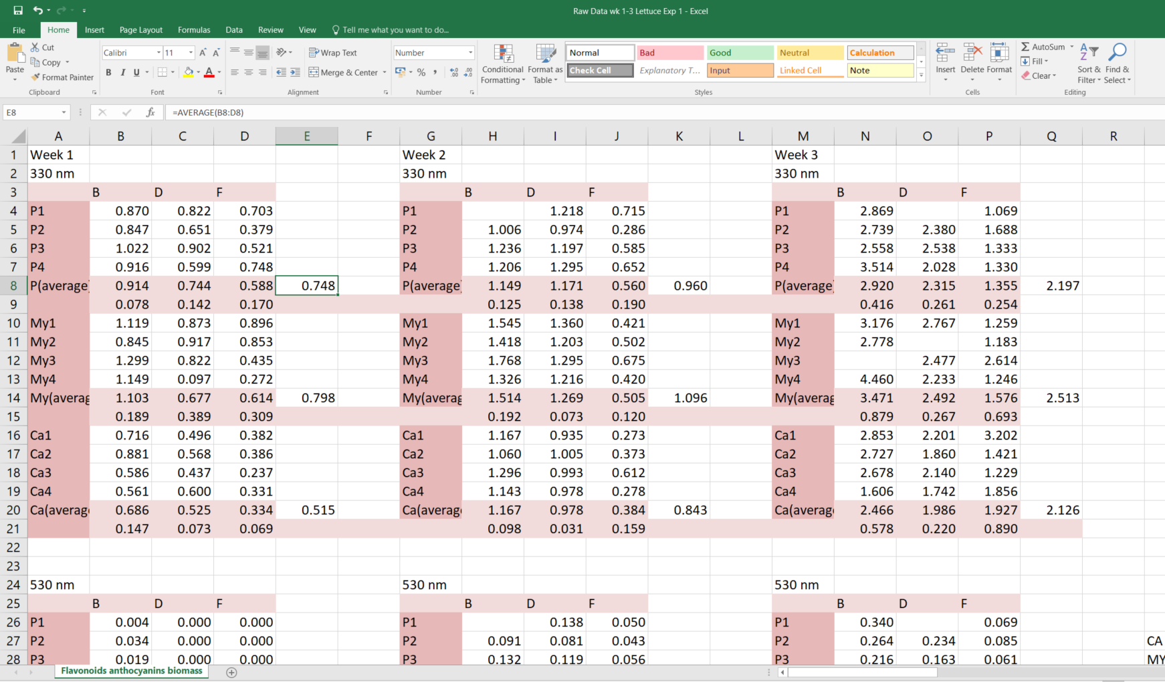
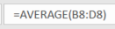
Real data comes with real problems
?

Slide 34
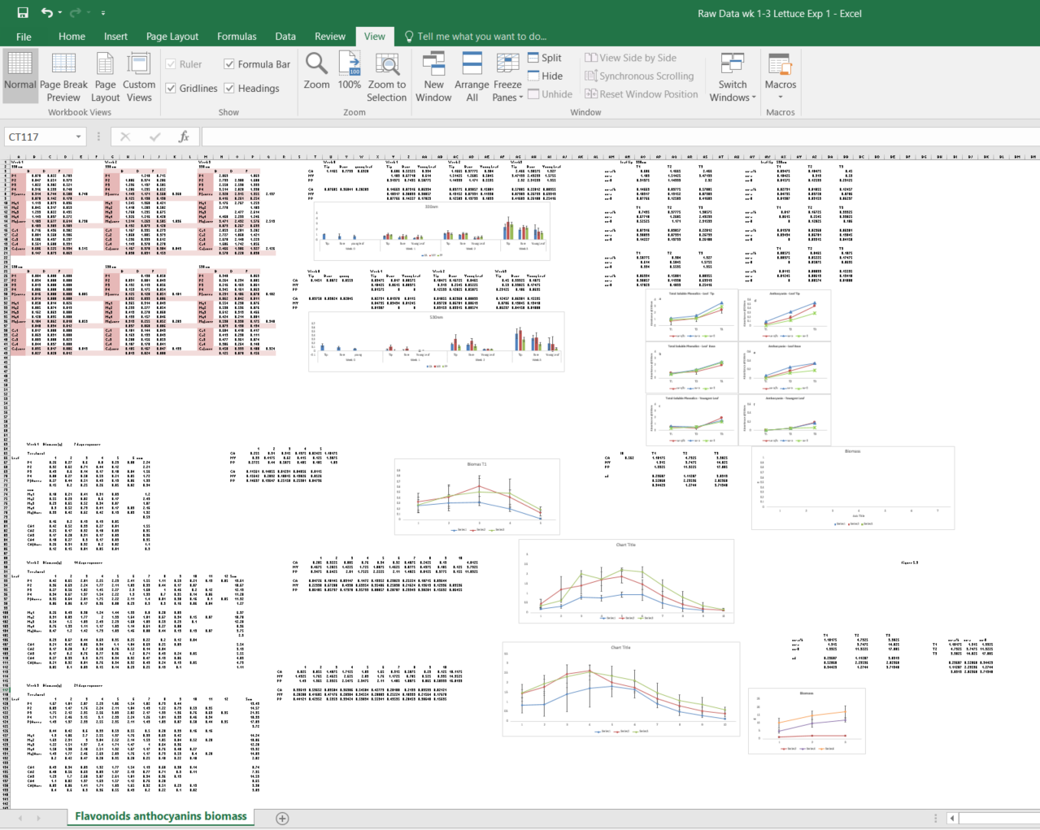

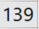

Slide 35
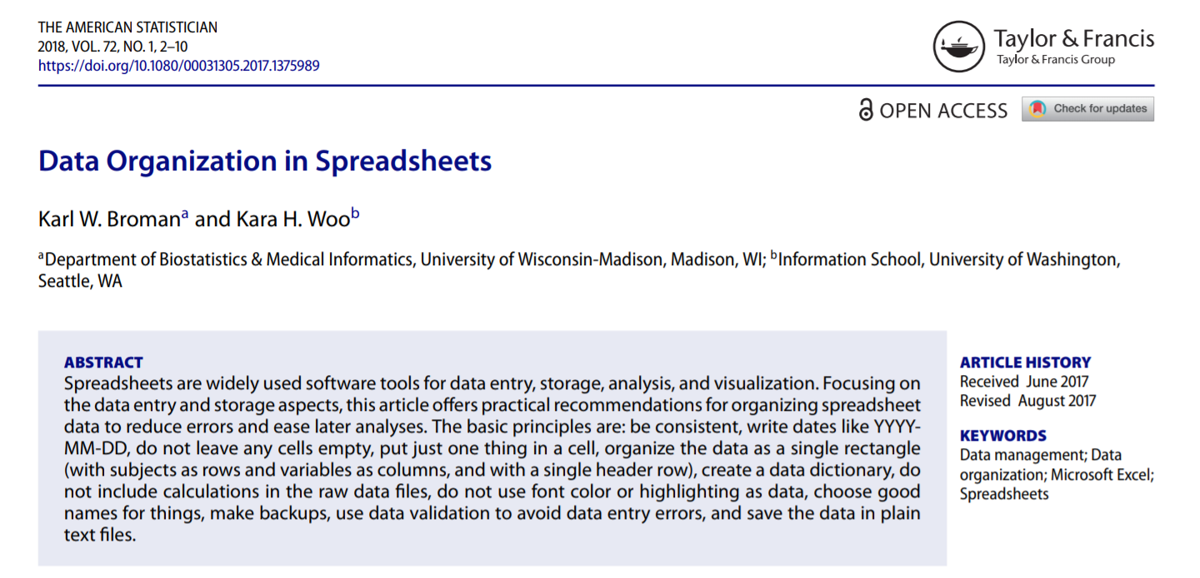
Take small steps to enact big changes
Notes:
Start reading from… The basic principles are…

Slide 36
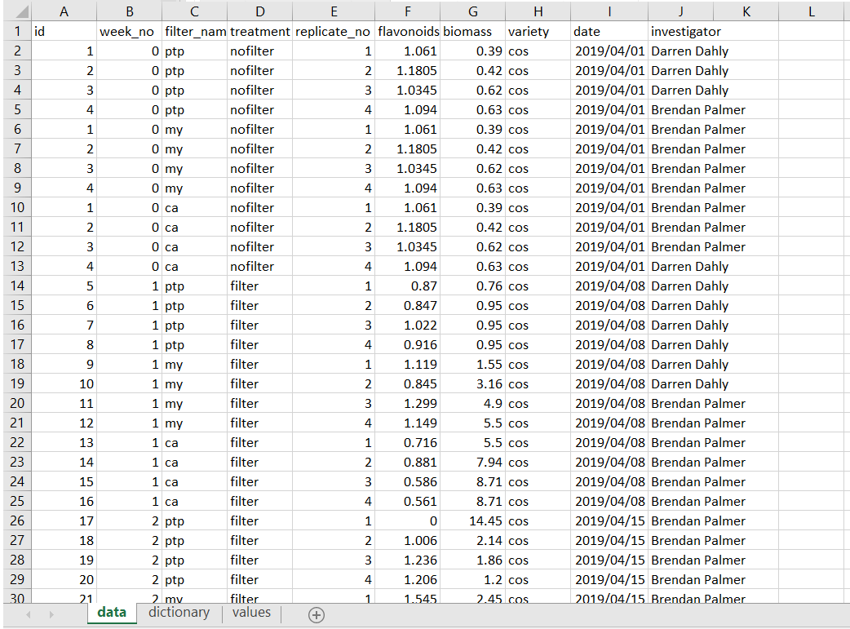
Less stress, more success
Notes:
You’re doing this work anyway
Do it smart

Slide 37
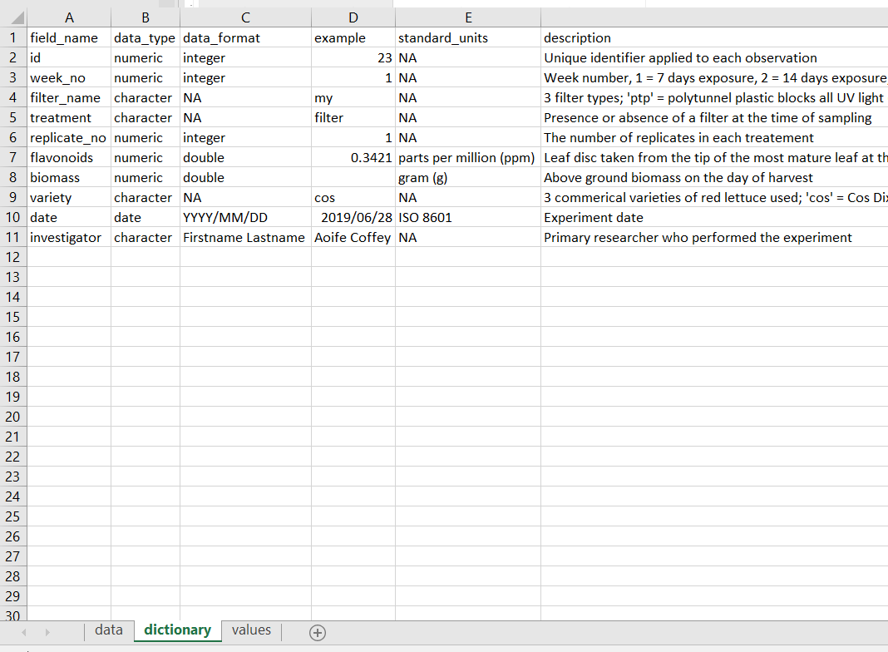
Less stress, more success
Notes:
This applies to any software you use in the future

Slide 38
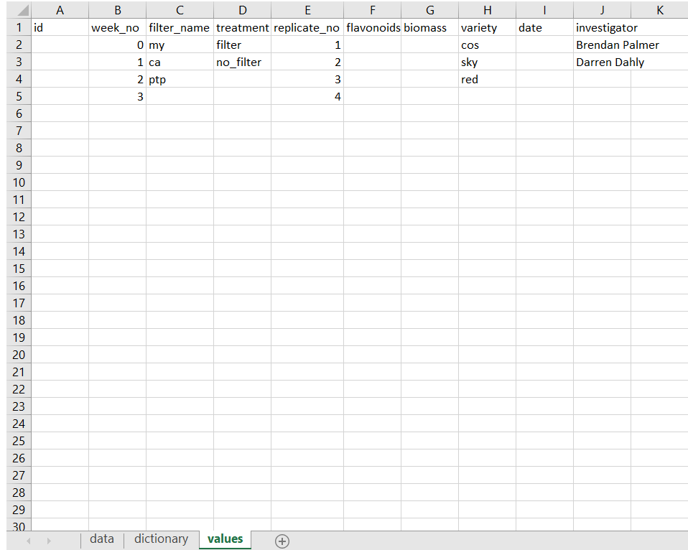
Less stress, more success
Notes:
This applies to any software you use in the future

Slide 39
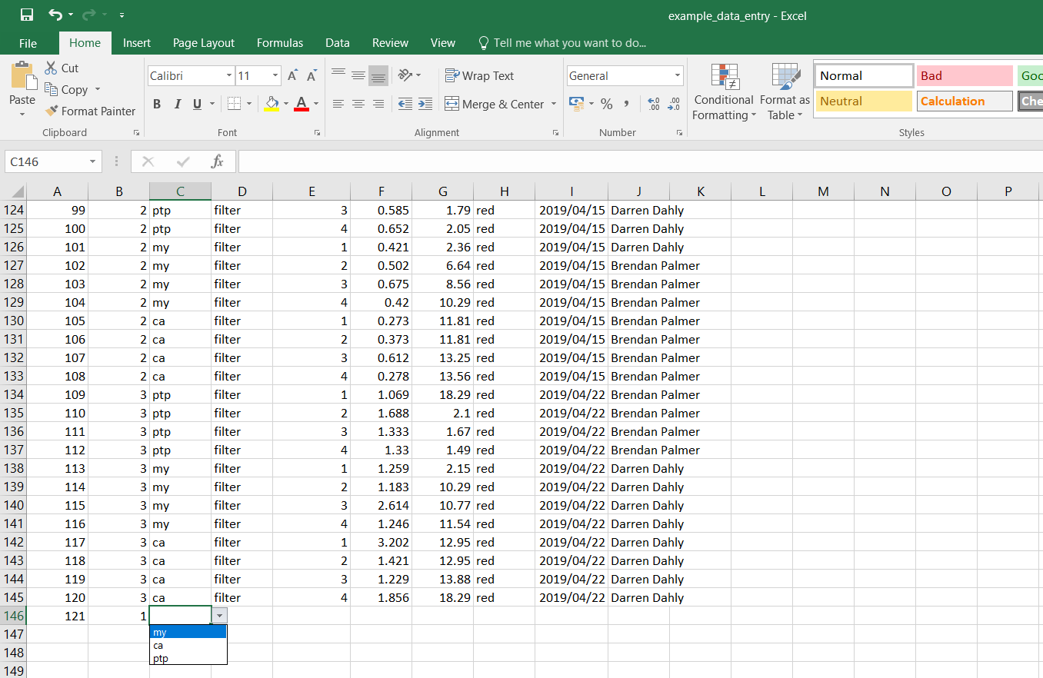
Less stress, more success

Slide 40
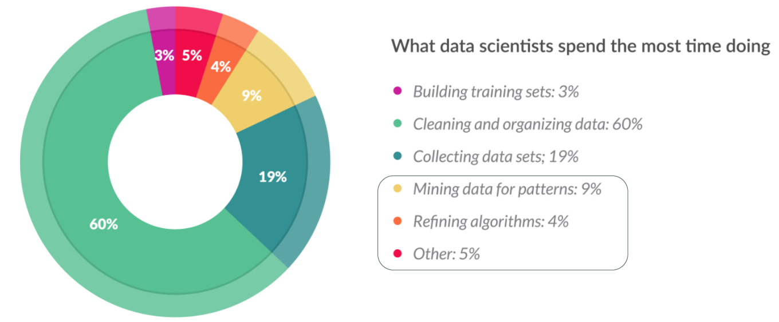
Resources are being wasted by not doing this
CrowdFlower (2016) Data Science Report
Notes:
And the funders are becoming aware of this

Slide 41
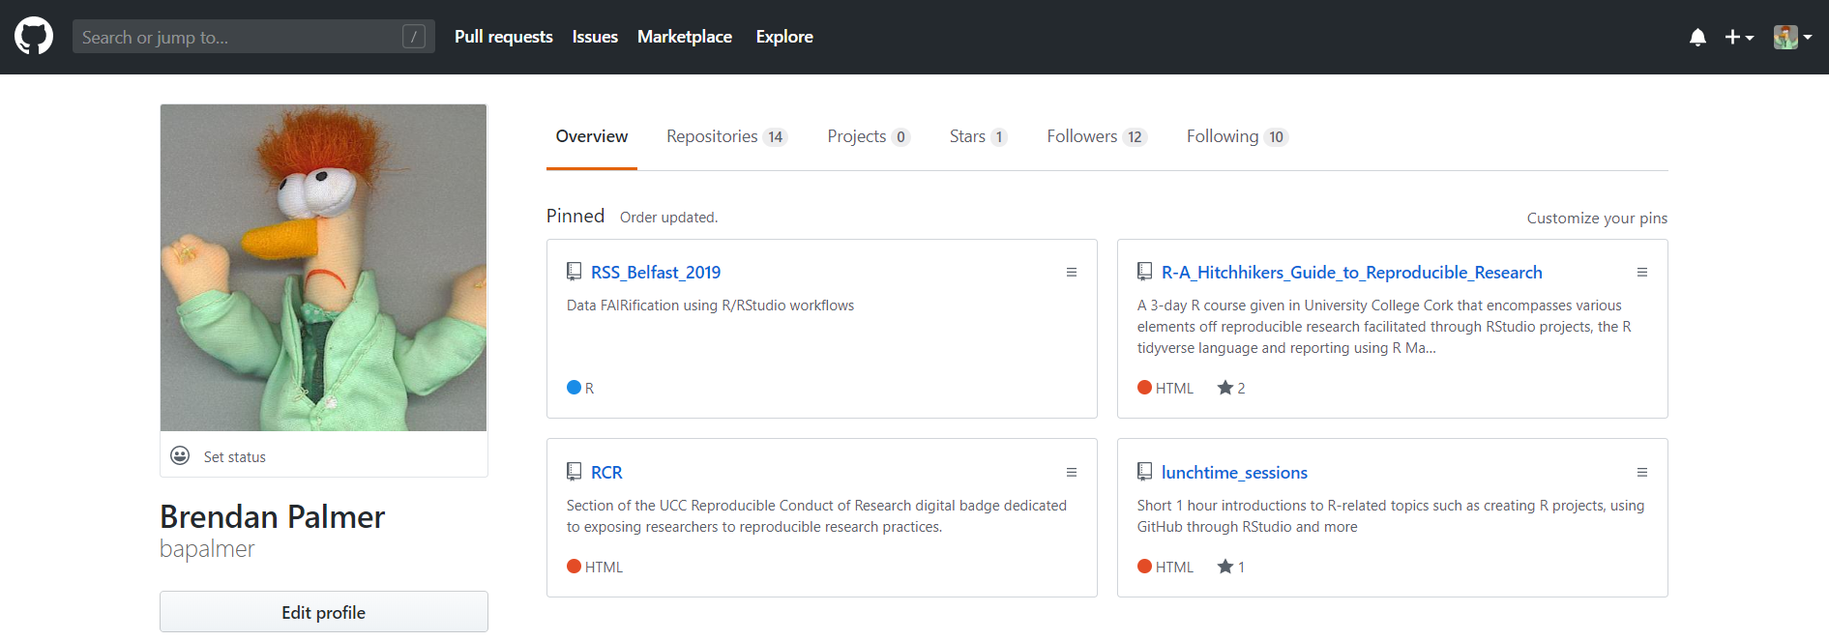
Try it out yourself
Notes:
Spend a minute looking at the Binder repository
Focus on the Hole punch script and how simple it is
- Holepunch pre-built Docker images

Slide 42
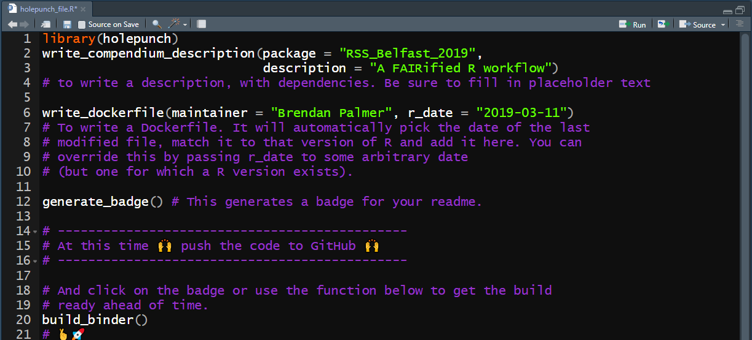
It doesn’t get much easier than this!
Notes:
Spend a minute looking at the Binder repository
Focus on the Hole punch script and how simple it is
- Holepunch pre-built Docker images

Slide 43

Hello… Is anyone there?...
Notes:
If you can’t email the author, what hope do you have of getting the data/materials/code?
- emailed 265 random author addresses
- Using statistical modeling, the authors estimate that 2.1% of addresses (about 69,000) go dark each year, and that 18% of all MEDLINE addresses are now invalid. (Those results, the authors note, are “less bleak” than a 2006 study, which estimated that a quarter of all email addresses go stale within one year, rising to about half by five years.)

Slide 44







Can I see your data an code?
1989
2019
1999
2009
Also 2019
Notes:
I just when randomly through the archives of a journal I’m familiar with to see how the contact information has evolved over the years
Last image has just under 2,500 authors

Slide 45


Notes:
- I found this example randomly
Comment on the body of work that formed the underlying data for the paper as opposed to the information in the final publication

Slide 46

Here today but maybe gone tomorrow?

Slide 47

Putting the final pieces into place

Slide 48

Lots of inspiration to be found at #RSS2019Conf
Siobhan Carey – Mondays Keynote

Slide 49


Acknowledgements/Local Supports
Dr Darren Dahly
Dr Brendan Palmer
Eoghan Ó Carragáin
Dr Aoife Coffee

